Slide 1
Capstone Project On
Credit Card Default Propensity Prediction
Group 3 | PGP-DSE July 2019 (Pune) | 28 Nov. 2019
Presented By -
Pratik Nirgudkar
Akash Patil
Pranil Shinde
Shivam Kulkarni
Akshay Sonawane
Guided By -
Mrs. Anjana Agarwal

Slide 2
Problem Definition
Problem Statement:
Predict the probability of a customer defaulting payment for the credit card of the subsequent month, based on past information.
Objective :
The fundamental objective of the project is implementing a proactive default prevention guideline to help the bank identify and take action on customers with high probability of defaulting to improve their bottom line.
Why It Is Important:
In the last few years, credit card issuers have become one of the major consumer lending products. Credit cards issued by banks hold the majority of the market share with approximately 70% of the total outstanding balance.

Slide 3
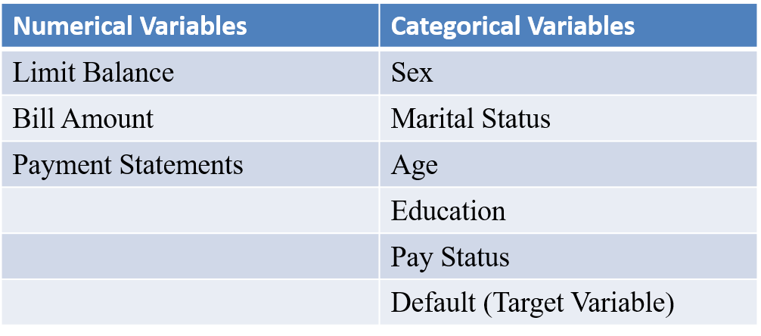
Suggested solution for the defined problem
As our data being a binary classification problem where we have to predict the customer being a defaulter or non- defaulter, we will find the best classification algorithm to predict credit card payment defaulters.
Features

Slide 4
Exploratory Data Analysis Inferences
There are no missing values in the Dataset.
Data Cleaning:
Education: The feature has unique values in a range 0 to 6. Where 0,5 and 6 were undefined. After EDA and pattern finding we found out that these can be defined under category 4 – Others.
Marriage : Has a label 3 that is undocumented, which can be categorized as 0- Others.
"Other" in education can be an education lower than the high school level.
"Other" in marriage could be, for example, "divorced".

Slide 5
Considering that about 22% of the customers will default, we see a couple of things:
Df[‘DEFAULT’].value_counts():
0 23364
1 6636
Though there are significantly more women than men in the dataset but men are most likely going to default the next month.
Considering the marital status, married men have a higher probability of defaulting, in spite of more number of single men in the data.

Slide 6
Challenges Expected/Addressed
The Credit-Card domain was new to us and there was no basic idea that how the billing cycle works.
The six months Pay_Status columns had unique values ranging from -2 to 8 out of which ‘-2’ and ‘0’ were undefined .
The Bill amount variables consists of negative values , whereas Pay amount consists of many 0’s. We were not able to find any pattern as such which would signify the customers Limit balance.
Our dataset was highly skewed and consists of large amount of extreme values.

Slide 7
Also, there exists negative values and zeros , so we were unable to apply the transformations such as log, sqrt, exponential and Box-cox transformation.
We achieved a considerable normalized distribution after applying Quantile transformation and as a result the skewness of the data was treated.

Slide 8
Feature Selection and Extraction
Pay_Status :
The values -2 and -1 shows that the customers have always paid on time. Positive values shows the number of payment default month by customer and 0 shows that the Customers have paid the bare minimum required to keep the account active, are good customers.
Therefore we created a variable RISK Category on the basis of previous pay status.
AGE_Category:
We found a 3 modal data distribution on the basis of which we created a new Age_Cat feature by bracketing the ages as Young, Middle, Senior. The Age_Cat have considerably more correlation with target than the earlier Age variable.

Slide 9
Algorithms considered:
Model | Accuracy | FN | F1 Score | Recall | AUC
Logistic (Base model) | 0.79 | 1339 | 0.27 | 0.18 | 0.75
Logistic (After Adjusting Threshold) | 0.70 | 483 | 0.50 | 0.70 | 0.75
Random Forest (Basic model) | 0.78 | 1208 | 0.35 | 0.26 | 0.70
Random Forest (After Hyper Parameter Tuning) | 0.79 | 1184 | 0.37 | 0.27 | 0.74
GBM | 0.79 | 1150 | 0.38 | 0.30 | 0.73
X-G Boost | 0.79 | 1134 | 0.39 | 0.31 | 0.74

Slide 10
CONCLUSION
Following the machine learning pattern, we have selected features (both predictors and target), distributions, built models and evaluated the performances of each model. Different models are used, including logistic regression, Random Forest Classifier, GBM and XGBoost. The techniques in evaluating the performances of the models used are recall score, F1 score, ROC_AUC and Confusion Matrix – False Negatives. After hyper-tuning the parameters in all models, Logistic regression model out performs others by adjusting the threshold.

Slide 11
FUTURE SCOPE:
To lower the risk of default, lenders must be very cautious on clients payment behavior.
Marketing campaign should be aiming on clients' age from 26 to 35.
More cautious on Divorce and High School level clients.

Slide 12
Thanks!

